Slide 1
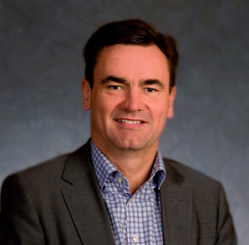
Søren Marcussen
CSO i RPC Superfos siden 2008

Slide 2
Speed to Market RPC Superfos
Søren Marcussen

Slide 3
Norway
3

Slide 4
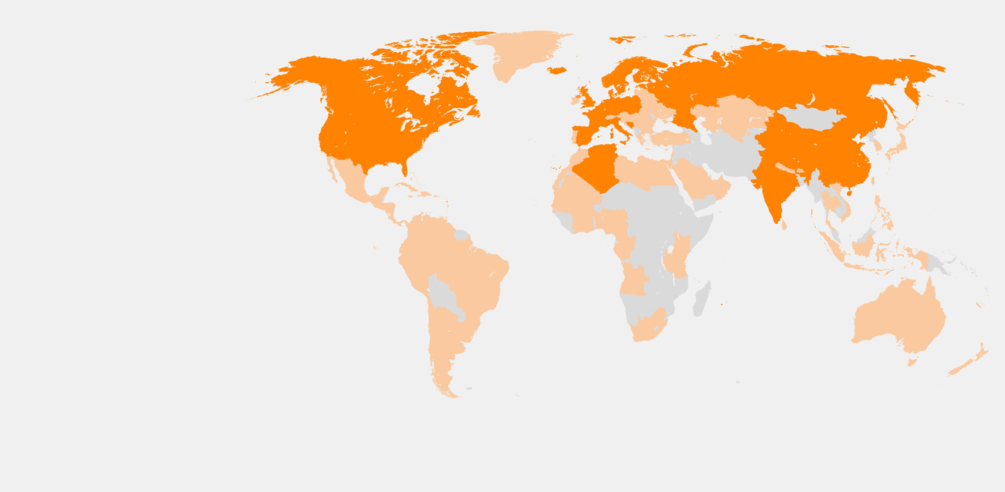
RPC Key facts
91 manufacturing operations in 24 countries
Over 15,000 employees
Largest European plastic converter
Industry leading innovator
Listed on London Stock Exchange - 1993
Member of the FTSE 250
4
Where we manufacture
Where we sell
RPC Group is well placed to support its customers globally with leading design and engineering capabilities

Slide 5
Corporate history
Turnover (£m)
Turnover: Reported
Turnover: Analyst expectations
Number of manufacturing sites
Manufacturing sites
Ace acquisition
M&H acquisition
Various smaller acquisitions
Superfos acquisition
Acquisition of 11 sites from Rexam / Nampak
5
Acquisition of Wiko division
MBO
Flotation
Impact of Promens and Pet Power
UK growth phase
Mainland European growth phase
Consolidation
Selective growth

Slide 6
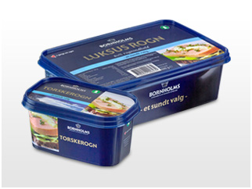
RPC Group Overview – RPC Market Segments
RPC Group Plc
Dairy
products
7%
Food 55%
Long
Shelf Life
7%
Surface
coatings
9%
Other food
20%
Other non-food
17%
6
Single serve
Beverage systems
11%
Pharmaceutical
4%
Spreads
10%
Personal care
and cosmetics
15%
Source: RPC Full Year Results 2013/14
Non-Food 45%

Slide 7
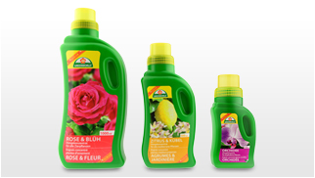
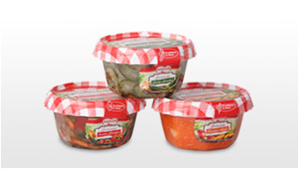
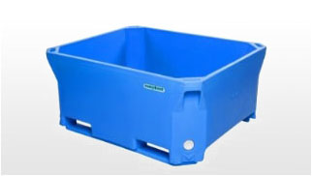
Conversion processes
Injection moulding
Blow moulding
Thermoforming
Rotational moulding
7
Complex designs High level decoration High added value
Re-closable
Narrow neck
Pourable
High volume Low cost
Barrier applications
Extremely versatile
Low tooling costs
Smaller volumes
RPC's core capabilities include the four processes which represent over 90% of all rigid plastic manufacturing processes. This allows RPC to offer the widest range of options to customers.

Slide 8
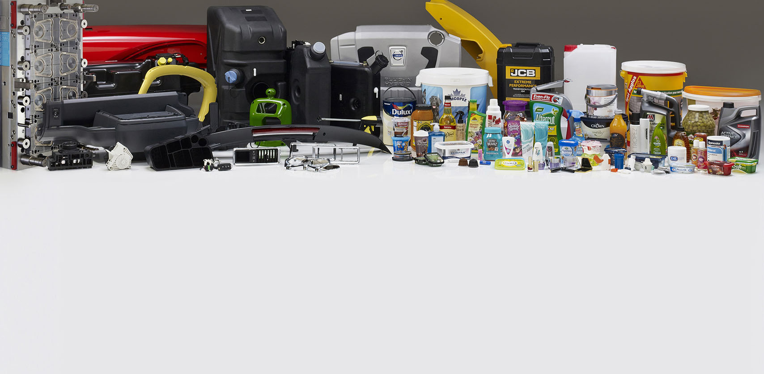
Leader in design and engineering - specialising in polymer conversion
8
RPC Sales 2014/15 – by end market*
RPC Sales 2014/15 – by destination*
Food 30%
Non-Food 23%
Personal Care 16%
Beverage 9%
Healthcare 4%
Technical Components 18%
Europe 86%
North America 8%
Asia 5%
Rest of World 1%
£1.7bn*
£1.7bn*
by end market
by region
*Pro forma to include a full year of acquisitions

Slide 9
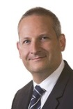
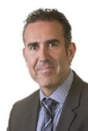
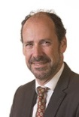
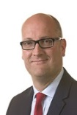
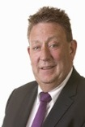
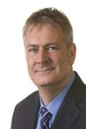
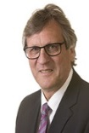
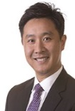
Experienced international management team
RPC Group Plc
Executive Board Members
Group Purchasing
Business Improvement
Corporate Development
Pim Vervaat
Simon Kesterton
Darin Evans
Frank Doorenbosch
Tom Saunderson
8 years
12 years
19 years
26 years
5 years
Chief Executive
Group Finance Director
Superfos
Bramlage
Promens
Bebo
Ace
René Valentin
Alfons Böckmann
Alistair Herd
Thomas Wahlmeyer
Jack Yeung
25 years
40 years
28 years
34 years
15 years
Superfos
Injection moulded product range for consumer and industrial markets
Bramlage
Personal and healthcare, single serve beverage systems
Promens
Blow moulded product range for consumer and industrial markets, speciality vehicles, rotational moulding
Bebo
Thermoformed product ranges for food market and single serve beverage systems
Ace
Asian precision engineering growth platform including mould making
Key focus areas
Experienced international management team with over 200 years' experience in the plastic conversion industry

Slide 10
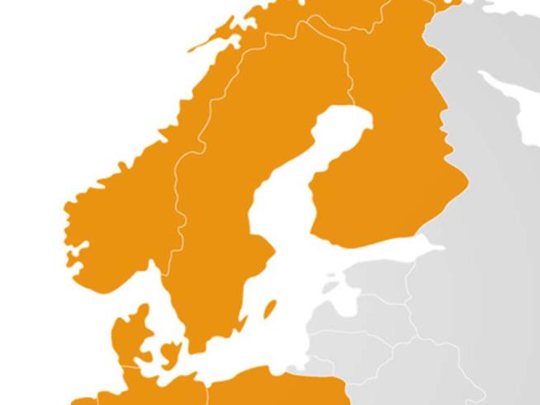
RPC Superfos Nordic Sites
Pori (Ulvila)
9
Oslo
Lidköping
Mullsjö
Randers
Stilling

Slide 11
Speed kills
for the ones who haven’t got it!
10

Slide 12
Speed to Market in 3 dimensions: New Product Development New Designs Daily Deliveries

Slide 13
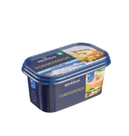
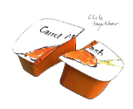
RPC Superfos – Speed to Market – New Products (Bespoke)
7
Customised pack is ready for production
6
Last modifications
5
In 5 to 6 months, our project team will take you all the way from first idea to the final customised packaging solution on shelf.
Packaging samples
11
4
Testing prototypes
3
Creation of tools, mould, artwork design
2
Design proposal
1
Ideas, objectives & feasability

Slide 14
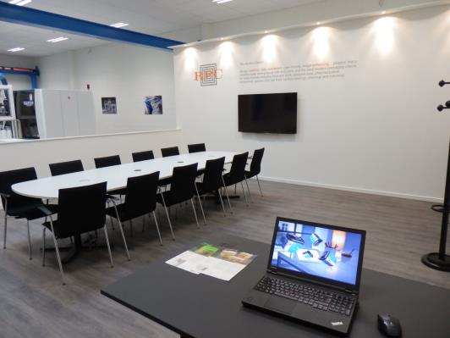
RPC Superfos – Speed to Market – Innovation Centre
Get the right idea here.
Take a look at your bespoke pack or prototype.
Discuss fine tuning, if any.
12

Slide 15
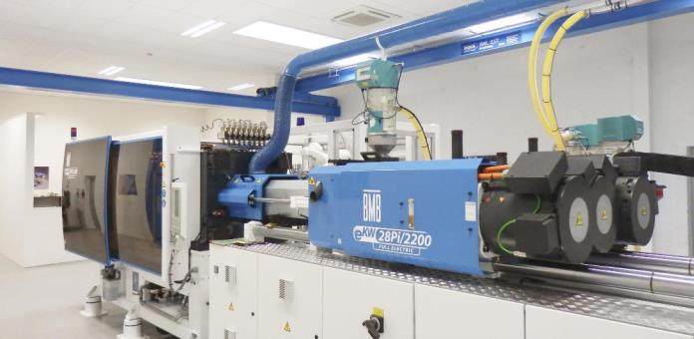
New Innovation Centre reduces lead time
13

Slide 16
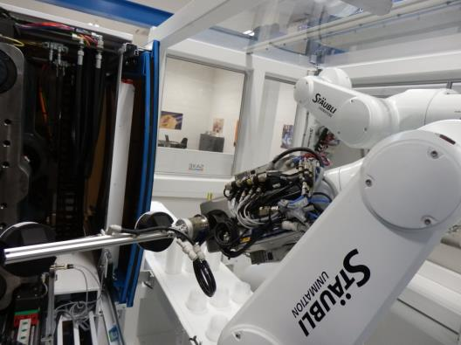
RPC Superfos – Speed to Market – Innovation Centre
Dedicated sample production
- no need for a time slot.
14

Slide 17
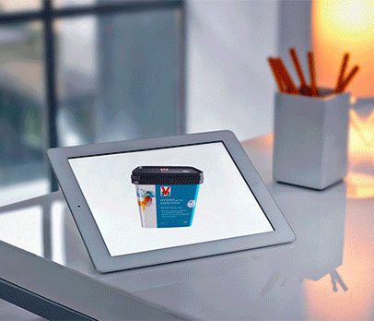
RPC Superfos – Speed to Market - TurnAvisual
Create artwork online in 3D – and save time
Save time to market
Quick, cost efficient, easy to use
Several decision makers can share ideas online
“From the render in 3D, we could see exactly how a suggested idea would turn out on the tub”
Said by Food Products International
about the TurnAvisual tool
15

Slide 18
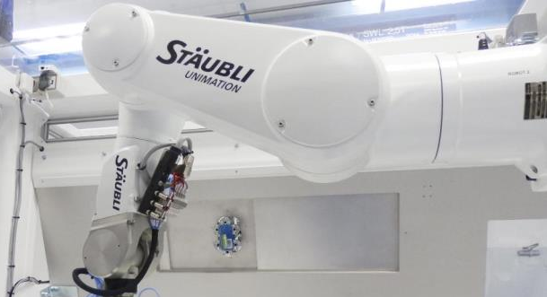
RPC Superfos – Speed to Market – Innovation Centre
RPC Superfos – Innovation Centre in Randers
Flexible change-over: volume, shape, quantity
16

Slide 19
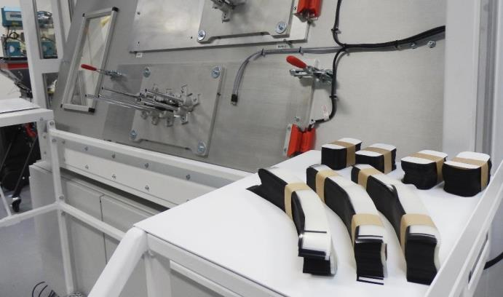
RPC Superfos – Speed to Market – Innovation Centre
Test machine: in-mould labelling, barrier labelling
17

Slide 20
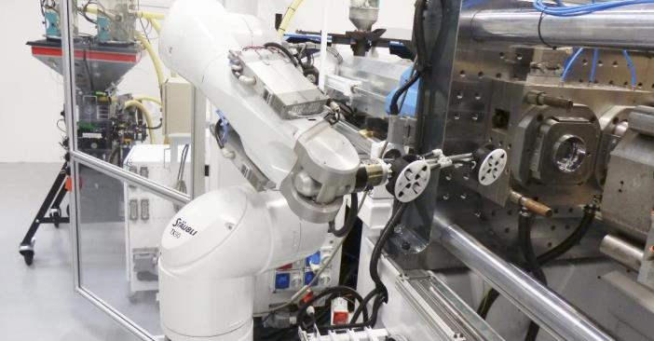
RPC Superfos – Speed to Market – Innovation Centre
Be close to the creation of your unique pack
18

Slide 21
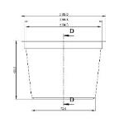
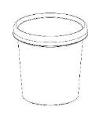
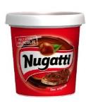
RPC Superfos – Speed to Market – Customised Solutions
Speed to market, an example
19
June/July
August
September
October
November
December
Product proposals, negotiations etc.
Final sign off with customer
Presentation meetings,
Last modifications
Test samples ready
Production equipment installed
First delivery takes place

Slide 22
RPC Superfos – Some of our Customers

Slide 23
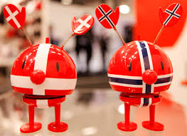
Norway
2011 Denmark - Norway 2-0 (EM-qual.)
20
Thank you!

