Slide 1

New Polymers that support Food Waste Reduction
Sandefjord, 6th November 2015
Mauri Azagury
Market Development Manager
DuPont Packaging & Industrial Polymers
EMEA region

Slide 2
Content
DUPONT vision on Food
Examples of Packaging innovation that reduces food waste:
    Example 1: Increasing shelf life of fresh meat thanks to better film properties
    Example 2: Dual compartment pouch to ensure longer shelf-life

Slide 3
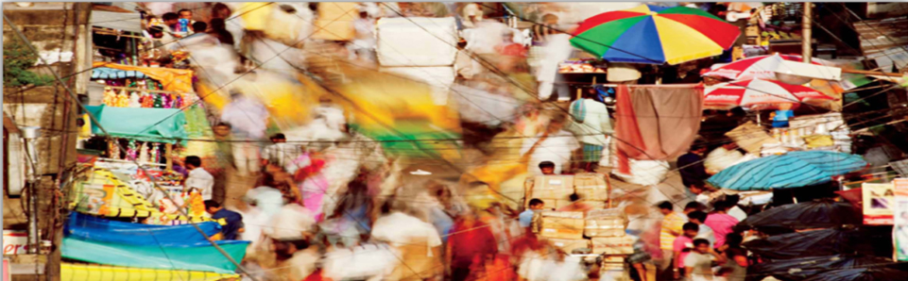
The Vision of DuPont
MARKET-DRIVEN SCIENCE
Our vision is to be the world’s
most dynamic science company,
creating sustainable solutions essential to
a better, safer, healthier life for people everywhere.
© National Geographic image
Notes:
We are a market-driven science company. Our vision is to be the world’s most dynamic science company, creating sustainable solutions essential to a better, safer, healthier life for people everywhere. We are applying our science to create sustainable solutions that make a difference in the world.

Slide 4


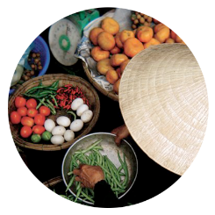


Our Areas of Focus
As the global population climbs up to 9 billion people in 2050, DuPont uses its science-powered innovation to help solve the challenges facing the world, with a focus on:
  FOOD
  ENERGY
  PROTECTION
Notes:
As the global population climbs up to 9 billion people in 2050, DuPont uses its science-powered innovation to help solve the challenges facing the world: Food, Energy and Protection.

Slide 5


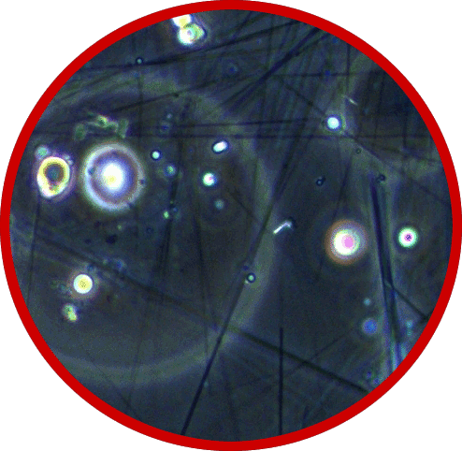
Our Strategic Priorities
Our strategy is to be a premier market-driven science company and generate
superior shareholder returns.
  AGRICULTURE &
  NUTRITION
  BIOBASED
  MATERIALS
  ADVANCED MATERIALS
Notes:
Given our purpose, what is our strategy to grow the value of DuPont?
It is to grow by building world-leading positions in three attractive spaces where we have strong science that is valued and rewarded by our customers.
They are Ag and Nutrition, Bio-based Materials, and Advanced Materials. Each of these areas offers us the opportunity to continue to build a distinctive portfolio of high-margin, growth businesses. The scope of our portfolio also enables us to leverage a broad set of scientific capabilities across our businesses, and to access many markets, providing significant opportunities to drive innovation across these spaces.

Slide 6




Our link to food ➔ from farm to fork
Food Ingredient
soy protein
Animal Health
Solutions
disease prevention
People Safety
business excellence
Anti-counterfeiting
robust & convenient
Crop Protection
optimal yield
Packaging
easy-to-use & durable
Microbiological
Safety
rapid & easy
Refrigeration
cost effective &
environmentally friendly
Seeds
Food service
hygiene & style
FOOD LOSSES
Insects, Diseases
climate
FOOD WASTE
Hygiene, Cold chain
Packaging , Shelf-life
Notes:
6
As an exemple… This shows you our involvement throughout the food value chain…from farm to fork.
We offer innovational solutions at every stage of the value chain.
Some examples:
Seeds, corn, soy: Pioneer®, HiBred
Crop protection: herbicide, fungicide, insecticides, pesticides
Chemical solutions: sanitarian
Food Safety diagnostics: Qualicon®, BAX® pathogen testing system
Soy protein: Solae™
Coatings & finishes: Teflon®, Tedlar®, Corian®
Packaging Solutions: Surlyn®, Elvax®, Nucrel®
Industrial safety, health and environment includes clothing and cleaning wipes.
Consumer awareness: of Teflon®, Corian®

Slide 7
Food Waste :
A Moral, Political, Economic Imperative
AT ISSUE

Slide 8
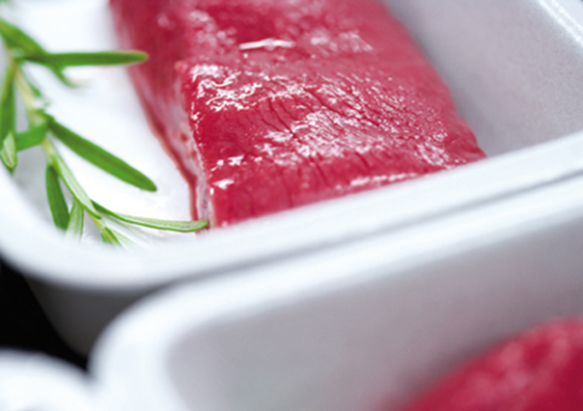
Example 1:
Increasing shelf-life of vacuum packaged fresh meat
PACKAGING INNOVATION THAT REDUCES FOOD WASTE

Slide 9
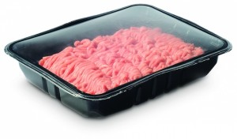
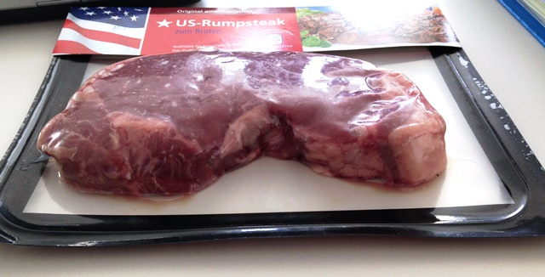
Project Background
Increasing shelf-life of vacuum packaged fresh meat
Vacuum packed meat is a growing trend, as it reduces packaging weight (and waste) and increasing shelf life vs conventional MAP…
MAP requires a deep tray and provides 7-10 days Shelf life
Vacuum Packaging can use a shallow tray and provides 4-6 weeks Shelf life
… BUT !
Meat loses drip /juices
Micro organism will grow
Eventually develops bad odour

Slide 10
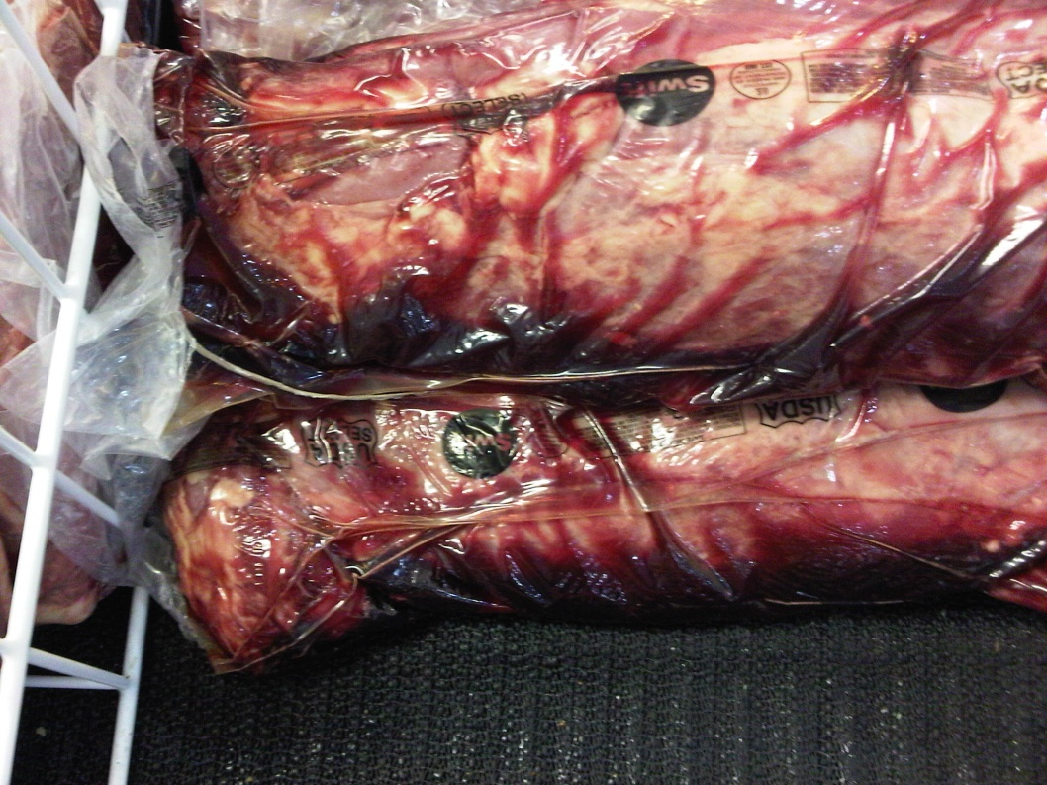
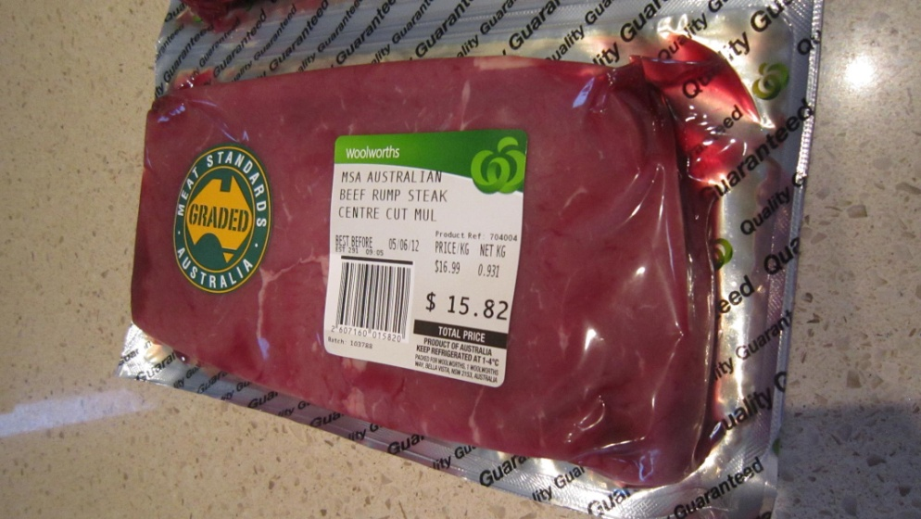
Project Background
Increasing shelf-life of vacuum packaged fresh meat
Labelling warning consumer about a possible odor and color change asking to wait 5-10 min before the odor is gone

Slide 11
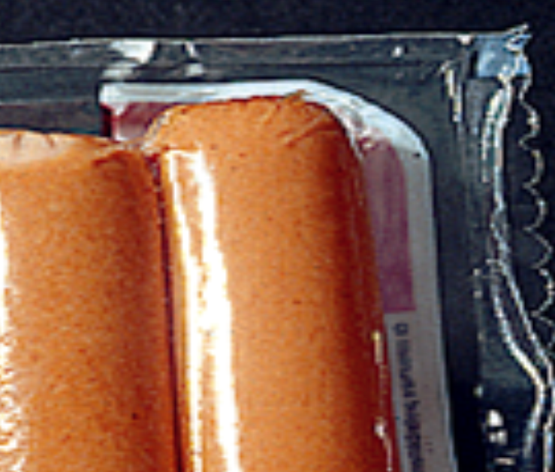
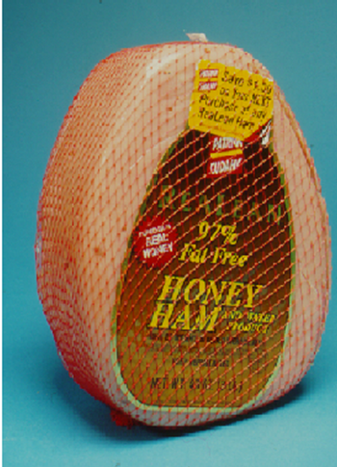
How can we reduce drip loss ??
Increasing shelf-life of vacuum packaged fresh meat
Secondary sealing
Meat adhesion

Slide 12
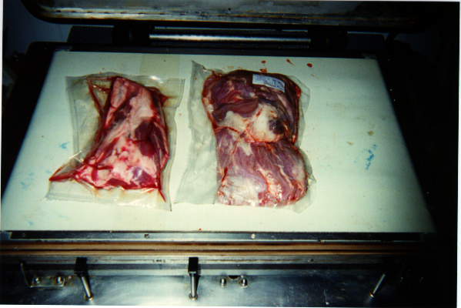
What is Secondary Sealing ?
Increasing shelf-life of vacuum packaged fresh meat
Bag with PE
Bag with new ionomer sealant
Secondary seal is sealing
All film area where there is no meat
By hot water bath or hot air tunnel
This process is currently used in meat to shrink bags
Primary seal area
Secondary seal area
Secondary sealing requires a sealant with:
1- Very low Seal Initiation temperature
2- Very good sealing in presence of blood and fat

Slide 13
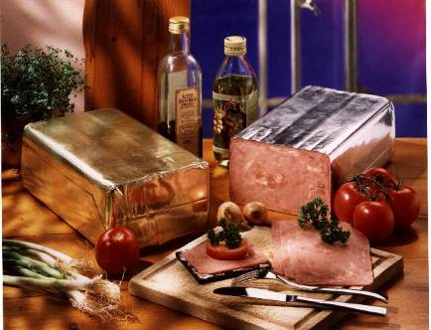
Why is Meat Adhesion important ?
Increasing shelf-life of vacuum packaged fresh meat
Some packaging film can stick to meat during the cooking process of hams and other deli-meats
This eliminates the separation of meat juices during cooking and makes ham slices more tender and juicy
How can we take advantage of meat adhesion without cooking ?

Slide 14
Increasing shelf-life of vacuum packaged fresh meat
The technology behind this new improved vacuum packaging for fresh meat:
Specific DuPont™ Surlyn® ionomer sealant resins, that provide:
enhanced meat adhesion and
secondary sealing properties
Using a simple 1sec dip in hot water
Improved Shelf life,
Reduces packaging weight
Eliminates use of absorbing pads .

Slide 15
Increasing shelf-life of vacuum packaged fresh meat
Technical data
Tests at an independent outside laboratory (TNO) showed that versus standard PE sealant, specific SURLYN® ionomer sealants could:
Reduce bacteria growth amount after 28, 42, 56 days
Reduce drip loss after 28, 42, 56 days

Slide 16
Conclusion
Increasing shelf-life of vacuum packaged fresh meat
A fresh meat packaging revolution is taking place with a new vacuum packaging concept that uses specific DuPont™ Surlyn® ionomer sealant resins with enhanced meat adhesion in order to :
Increase shelf-life of fresh meat
Reduce drastically the purging of meat juice in the bag
Eliminate the bad odour when opening the packaging.

Slide 17
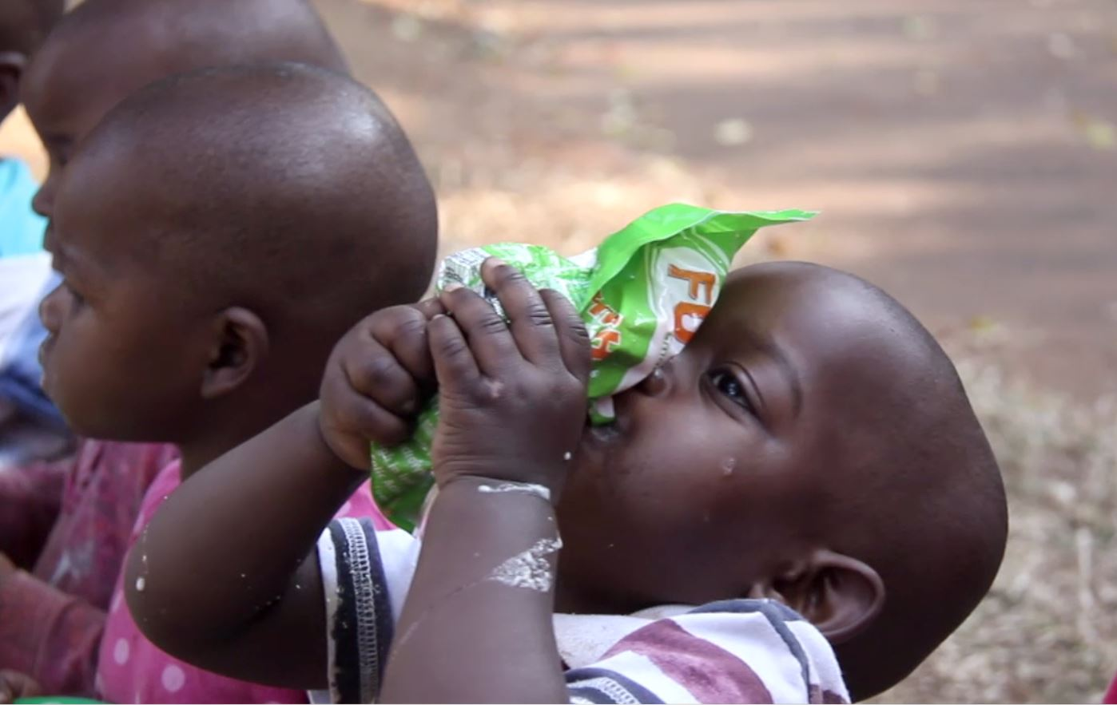
    Example 2:
    Dual Compartment Pouch with Frangible Seal
PACKAGING INNOVATION THAT REDUCES FOOD WASTE
“Problem to solve : long shelf life + food safety at min cost” .

Slide 18
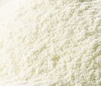


Dual Compartment Pouch with frangible seal
A Breakthrough in Food Packaging
Dual Compartment Pouch with Frangible Seal
A pouch with two or more compartments, separated by a frangible seal.
Squeezing the pouch bursts the internal seal allowing the content of the compartments to mix, without disturbing the outside seal.
POWDER
water
When you think of Frangible Pouch, think:
FOOD SECURITY
PRODUCT LIFE EXTENSION
CONTROLLED PRODUCT ACTIVATION

Slide 19
When Packaging adds Value to the Food Content
Separating ingredients until consumption
Dual Compartment Pouch with Frangible Seal
The best candidates for frangible pouches are contents or food formulations that benefit from having their ingredients separated until the time of consumption.
Powder milk & water | Keeps vitamins and nutriments intact, no need for refrigeration, no external manipulation
Probiotics | Keeps active principles intact In milk, no need to heat water to 70°C, so no risk of killing the active principles
Hydration salts | Mixing directly with safe water to increase the hydration result
Hydration + protein solutions for food crisis | Ease of shipment, no need for refrigeration, all-in-one solution, long shelf life

Slide 20
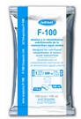
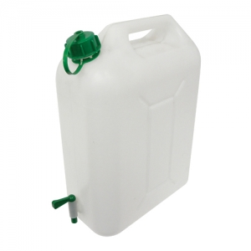
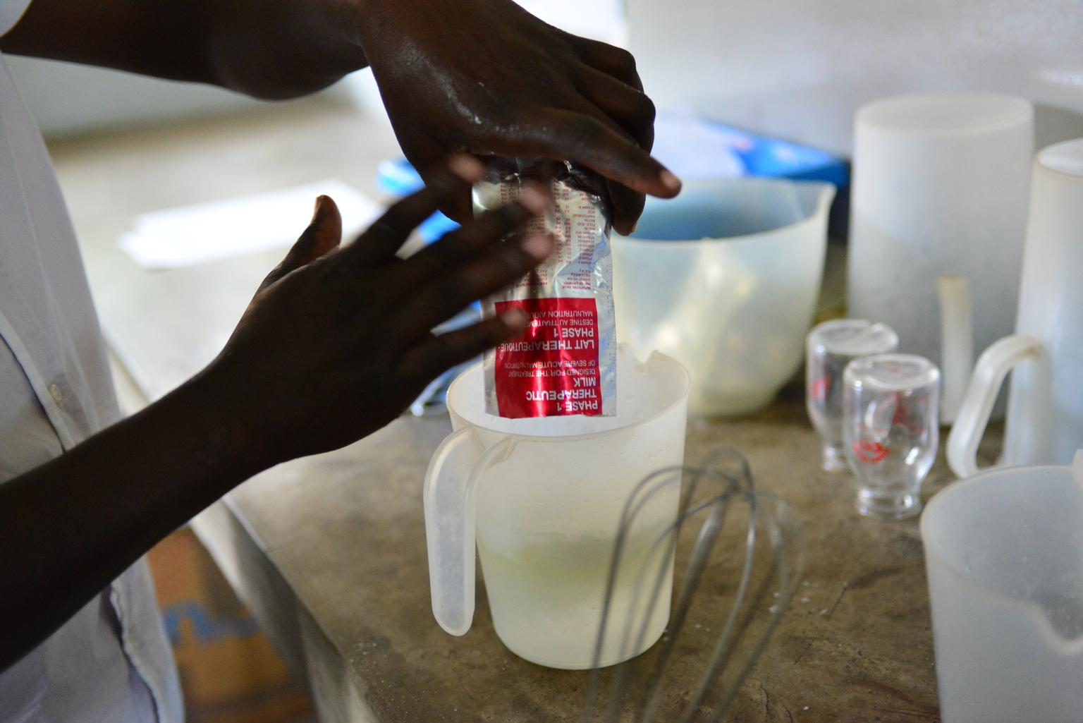
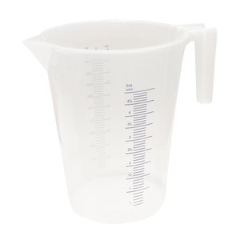
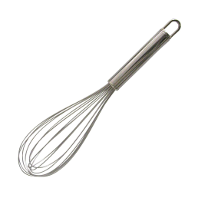
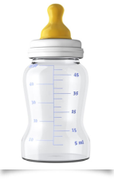
Convenience of use: for NGOs working in disaster areas From this…
Dual Compartment Pouch with Frangible Seal

Slide 21





… to this
Dual Compartment Pouch with Frangible Seal

Slide 22
Making powder milk easy to use
Eliminating the work-intensive steps
Dual Compartment Pouch with Frangible Seal
Eliminate the measuring scoop
No need for sterilization
No mess or clean-up
Ease of Mixing
No need to search for water source
Portable solution / at home use
No risk of external contamination
No need of refrigeration
No risk of wrong dosing
Safely Expand the Use of Powder Milk Outside the Feeding Centres

Slide 23
The Technology Behind Frangible Pouch
DuPont™ Surlyn® AD8273
Dual Compartment Pouch with Frangible Seal
Frangible pouches require two types of seals:
Strong seals for external sides
Frangible or burstable seal to separate the components
Surlyn® AD8273 provides both lock-up seals and frangible seals.
It does this by controlling the seal bar temperatures.

Slide 24
Conclusion
Dual Compartment Pouch with Frangible Seal
Dual compartment pouches with frangible seals is a lightweight and robust packaging solution to effectively bring food and hydration in disaster areas by:
Increasing shelf life
Eliminating the need for refrigeration
Providing clean water and nutrients
Avoiding dosing mistakes and wrong manipulation
In a simple and fast manipulation that saves time for doctors and nurses.

Slide 25

PACKAGING INNOVATION THAT REDUCES FOOD WASTE
While the industry continues the search for the holy grail ,
there are many smaller, more humble steps that can contribute to the reduction of food waste , case by case.
The DuPont Packaging and Industrial Polymers Group receives hundreds of visits per year in our European Technical Centre in Switzerland, from packaging converters and food companies, to discuss individual projects for the improvement of packaging efficiency, food safety and shelf-life.

Slide 26


